Slide 1

Peer Review Management System (PRMS)
“The Web Tool”

Slide 2
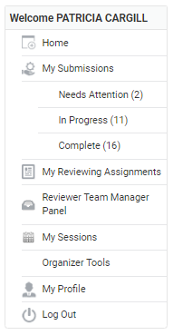
Overview of Navigation
My submissions – Authors
  submit and view progress of submissions
My reviewing assignments –Reviewers/Chairs
  Reviewers - review draft papers in draft and revised draft rounds
  Chairs- vet abstracts for presentation only in abstract round
My sessions -Chairs
  assign papers to session
  change session title, description
  add co-chair
  reorder papers, remove papers, add to other sessions
Organizer tools-Chairs
  view list of all papers in the track/session
  export Excel file showing all papers
  assign reviewers, view reviews, make paper decision
Note: Some navigation items will not appear until after a submission has been received.

Slide 3

Paper Assignment and Session Setup
For preparing the sessions for peer-review

Slide 4
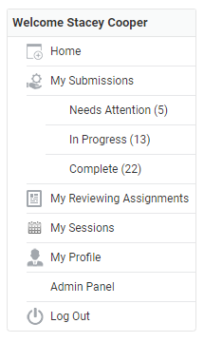

Papers must be assigned to sessions before reviewers can be assigned and reviews completed.

Slide 5
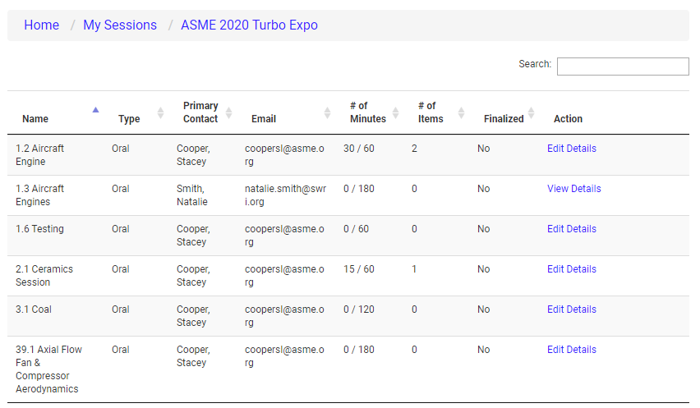
The list of sessions you have been assigned will be displayed on the next screen. Click on the “Edit Details” link to start organizing your session.

Slide 6
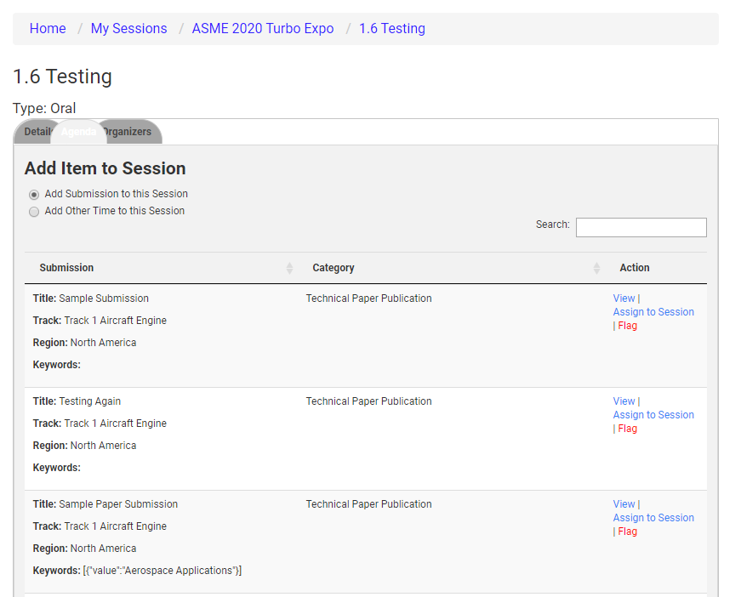
The Agenda tab is where you will start assigning submissions to the session.
Click on “View” to view the submission details.
Click on “Assign to Session” to move the submission into the session.
Click on “Flag” if the you feel that the submission should be assigned to another track. Staff will then re-assign as needed. You will be able to re-assign abstracts within your own track.

Slide 7
Updating Session Title
For chairs who need to update the session title

Slide 8
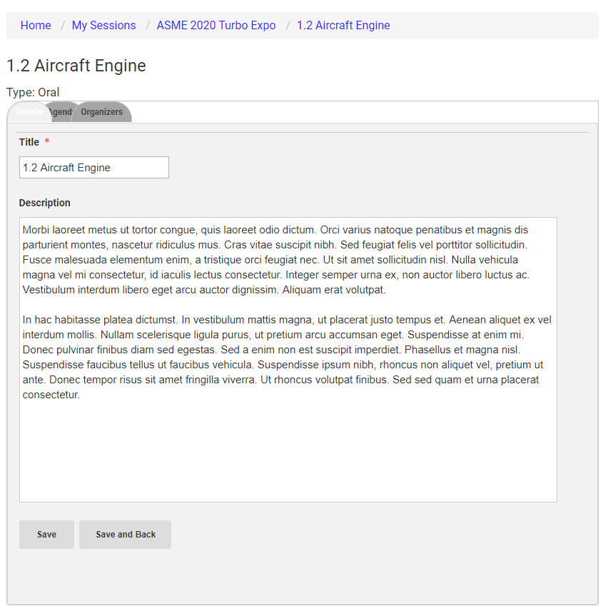
The first tab will let you adjust the session title and enter the session description.
DO NOT CHANGE NUMBERING

Slide 9
Adding Track/Topic or Session Chairs
For those tracks or topics requiring additional co-track/topic chairs or session chairs after the abstract review.

Slide 10
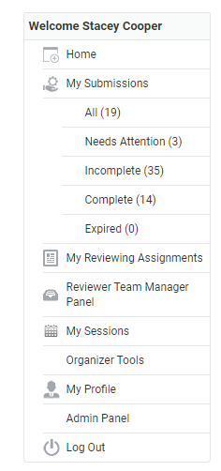
Login to your organizer account
Select My Sessions or My Topics/Sessions
(Only Primary Chair has access to do this)

Slide 11
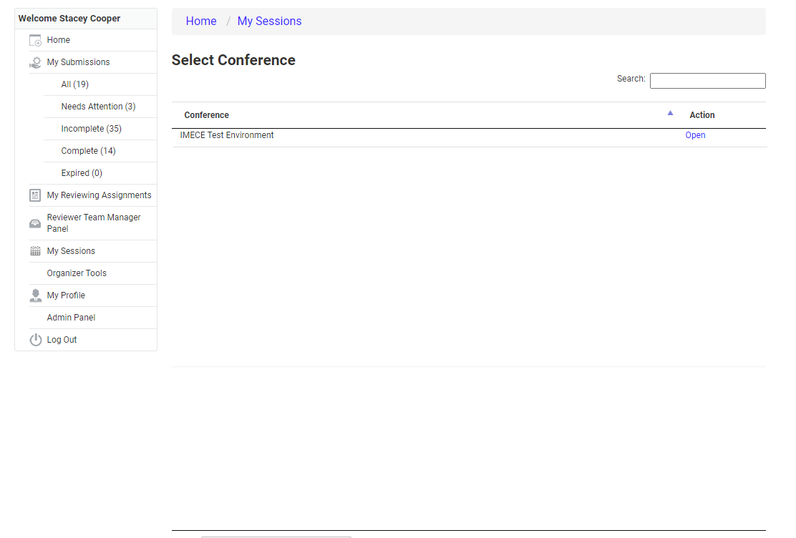
Select “Open” for the conference

Slide 12
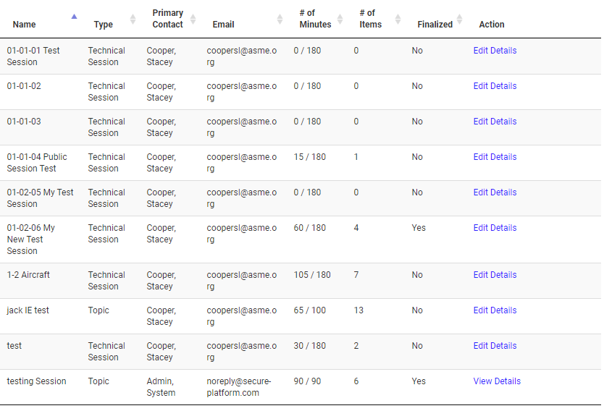
Select Edit Details
(Only the Primary Chair will have this link)

Slide 13
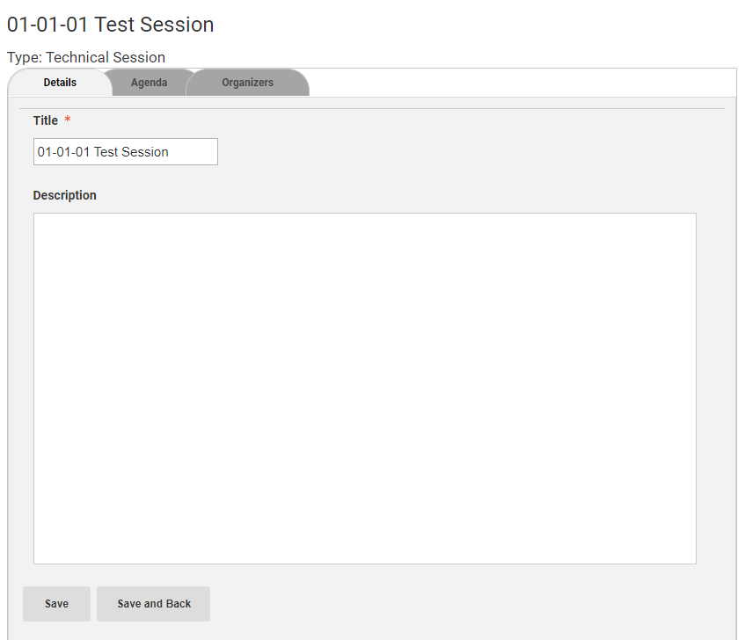
Select the Organizers tab
(Only the Primary Chairwill have this link)

Slide 14
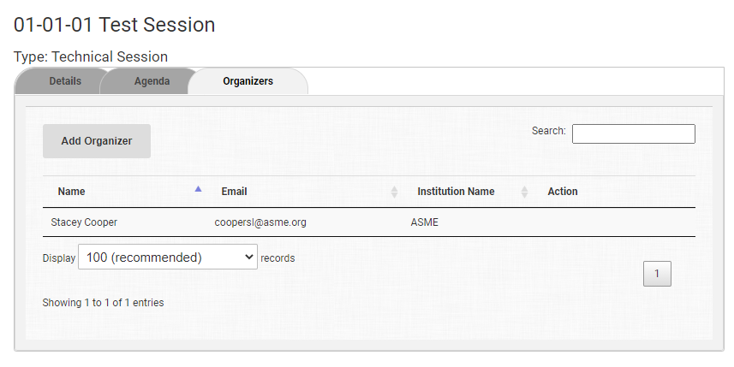
Click on the Add Organizer button
(Only the Primary Chair will have this link)

Slide 15
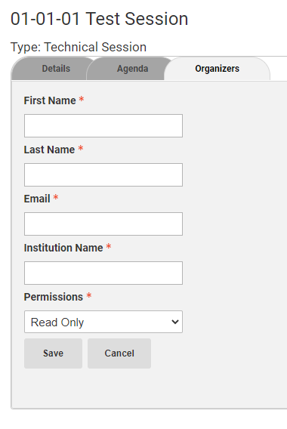
Type in required fields.
(Make sure to use the email the co-organizers uses to login to ASME or the chair may have login problems.)
Set the permissions to Collaborator
C0-chair will receive an email about the assignment.

Slide 16
Paper Review Process

Slide 17
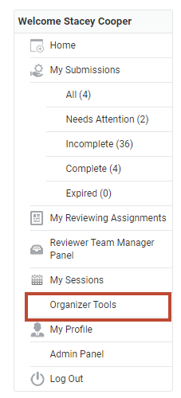
Login to your account
Click on “Organizer Tools”

Slide 18
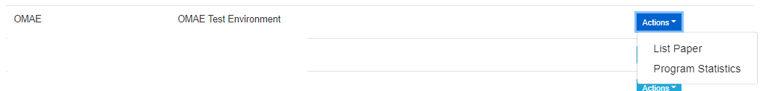
Click on “List Paper” to view the submissions.

Slide 19
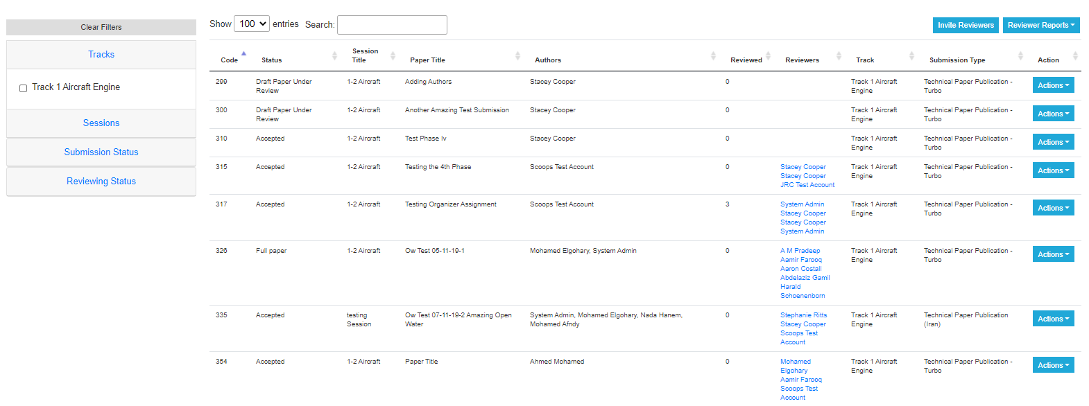
List Abstracts will take you to the paper review management screen.
Search: Enter any text that will may be displayed in one of the columns
Column Sorting: Click on the arrows next to the column to sort in ascending or descending order.

Slide 20
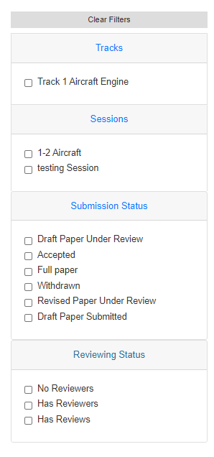
Filtering
Filter by
  Track
  Topics/Session
  Submission Status
  Review Status
Filtering will remain in place as you navigate through multiple pages.

Slide 21
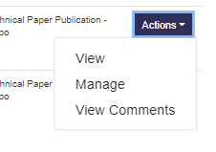
Paper Actions
View
  Opens a new window to view submission details (abstract, authors, draft paper submission, revised draft paper submission).
  Click on the navigation links to view desired page.
Manage
  Assign Reviewers
  Make Decision on Papers
  Click on Paper Title to view submission details.
View Comments
  View Reviewer Inputs

Slide 22
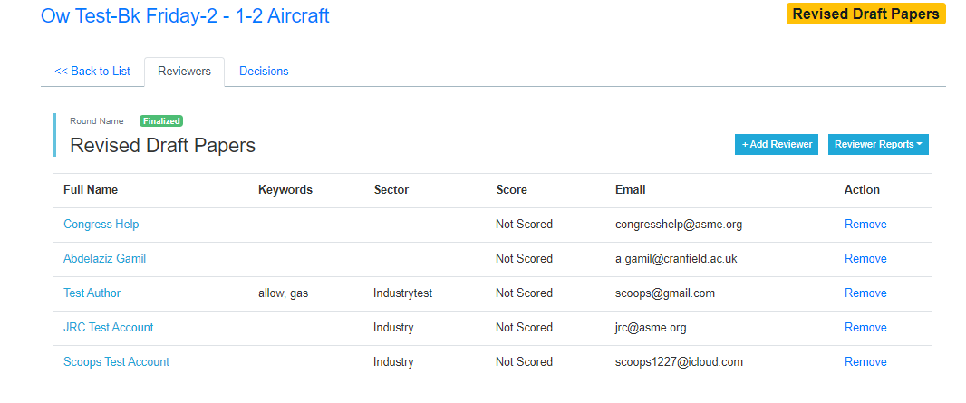
Assigning Reviewers
Click on “Add Reviewer” to search the reviewer database.

Slide 23
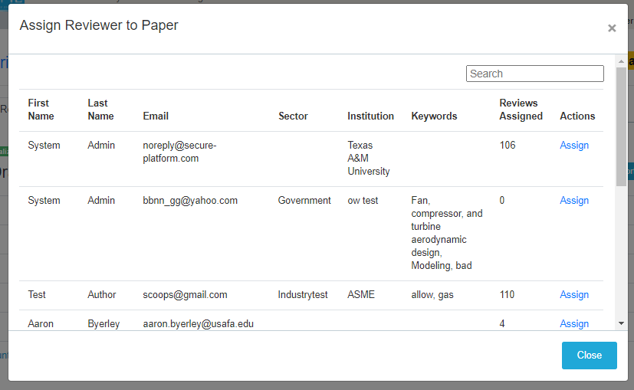
Assigning Reviewers
Search by
  First or last name
  Email address
  Keywords
  Company
The number of papers assigned to the review will be displayed.
Click “Assign” to add the reviewer
  Reviewers will receive an email notification for each assignment.

Slide 24

Can’t Find Your Reviewer
Go back to the previous screen and click on the “Invite Reviewers” button.
This will copy the URL below to your computer. Paste this into an email to your new reviewer.
https://interpack.secure-platform.com:443/a/judgeSolicitationProfiles/create?solicitationId=177

Slide 25
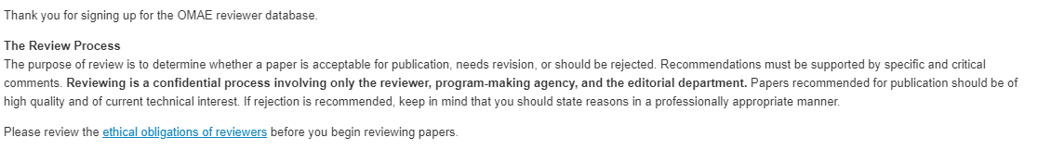
Reviewer Opt-In Guidance
Make sure your reviewer completes the opt-in process.
  Some new users to ASME stop the process after creating their ASME account.
    THEY HAVE NOT COMPLETED THE PROCESS!
Reviewers will see the text below when they have successfully opted-in.
Reviewers will become available for assignment approximately 30 minutes after seeing the above text.
Reviewer Opt-in Step-by-Step Process: http://asmetraining.wpengine.com/reviewer-database-opt-in/

Slide 26
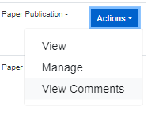
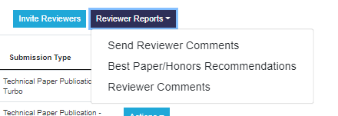
View Reviewer Comments
Go to Actions > View Comments
A new window will open displaying all reviewer inputs
Go to Reviewer Reports > Reviewer Comments
This will download a comma separated file (csv) with all reviewer inputs that can be imported into Excel.

Slide 27
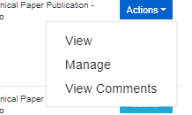
Make a Decision on the Paper
Go to Actions > Manage
This will take you to the paper management screen.

Slide 28
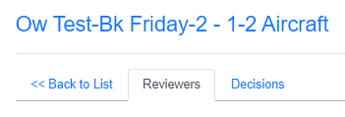
Make a Decision on the Paper
Click on the “Decision” tab

Slide 29
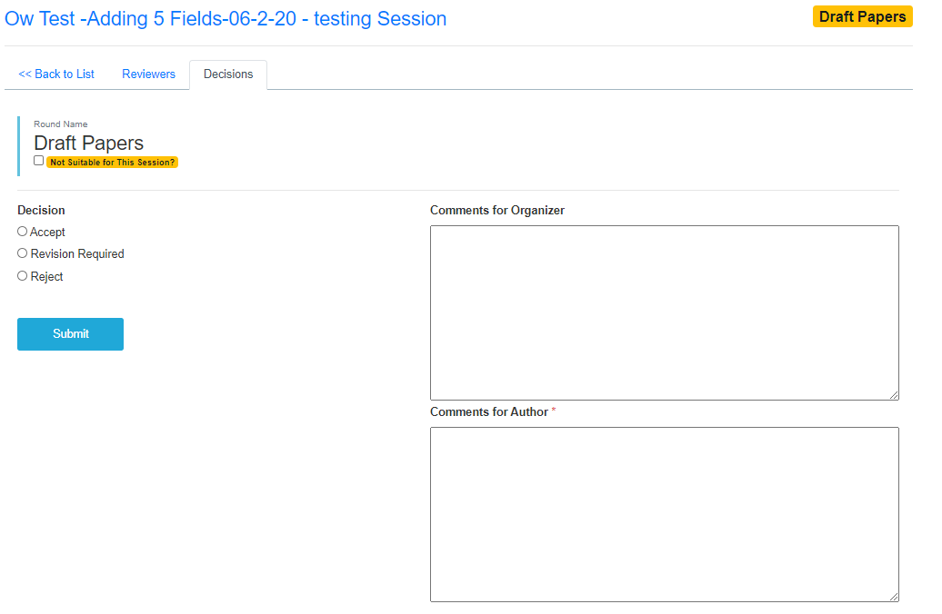
Make a Decision on the Paper
Make your decision selection
  Selecting “accept” will display the honors and journal recommendation options.
Organizers can enter optional comments fellow Organizers.
Fill in the required comments for the authors.
Minimum of 2 completed reviews required before a decision can be made.
Only request revised draft for major content changes, not minor issues like typos or formatting.

Slide 30
Schedule
Process has many steps that must be done in series
  All deadlines close at 11:59 pm ET
  Reviewers will lose access to submissions at this time
If you are late or incomplete to a deadline, it puts untenable pressure on the downstream steps
Deadlines are completion dates, not start dates
Start early!
Chairs need to check, monitor, support, and push along progress and quality throughout their span of responsibilities
  Send reminders to start tasks and meet deadlines
  Check status and address problems regularly

Slide 31
Questions/Help
For any problems, email toolboxhelp@asme.org.
For author problems, encourage the author to email toolboxhelp@asme.org,
with organizers on copy.
This will go to Lori Lee and her team. You DO NOT need to email both Lori and toolboxhelp.
Join us for our twice-weekly help center calls
Tuesdays @ 10:00 am New York Time | Thursdays @ 2:00 pm New York Time
Join online Meeting ID: 812 794 064 Password: 708266 One Tap Mobile: +19292056099,,812794064# US (New York) +16699006833,,812794064# US (San Jose) Dial by Your Location +1 929 205 6099 US (New York) +1 669 900 6833 US (San Jose) 877 853 5247 US Toll-free 888 788 0099 US Toll-free Meeting ID: 812 794 064 Find your local number here. | Join online Meeting ID: 277 957 717 Password: 625347 One Tap Mobile +19292056099,,277957717# US (New York) +16699006833,,277957717# US (San Jose) Dial by your Location +1 929 205 6099 US (New York) +1 669 900 6833 US (San Jose) 888 788 0099 US Toll-free 877 853 5247 US Toll-free Meeting ID: 277 957 717 Find your local number here.

