Slide 1
TECHCON Presentation Sample Slides Presenter Name followed by additional Authors University Presenter email address

Slide 2
How will you present during TECHCON?
Each conference room will have a podium that includes:
Microsoft Windows 10 laptop with PowerPoint 2019 and your presentation
Projector with wide-screen (16:9) display
Podium microphone
Presenter remote control, includes laser pointer and slide controller
Use of your own laptop is not allowed.
Your presentation file should be a PowerPoint file.
If necessary, a PDF file can be used in place of a PowerPoint file. This is heavily discouraged.

Slide 3
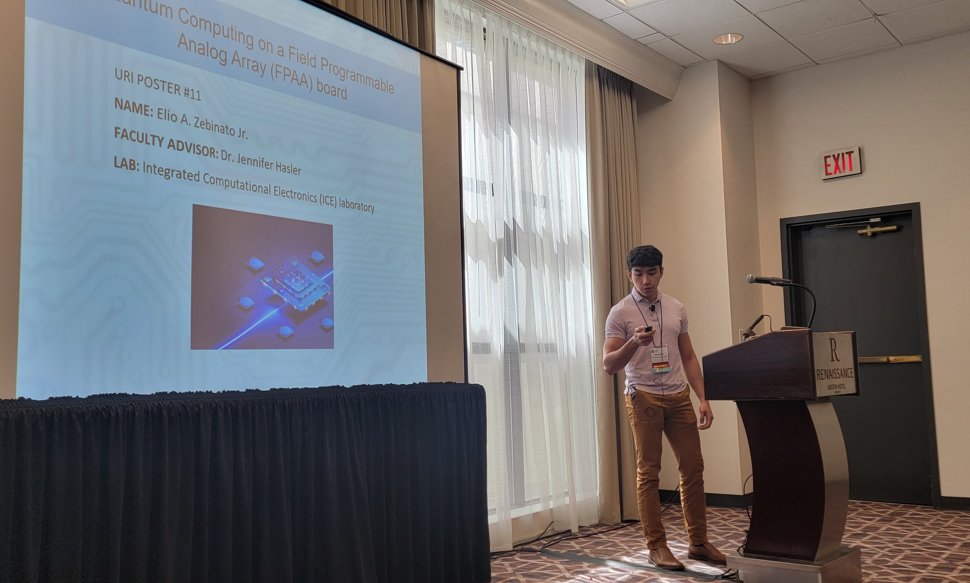
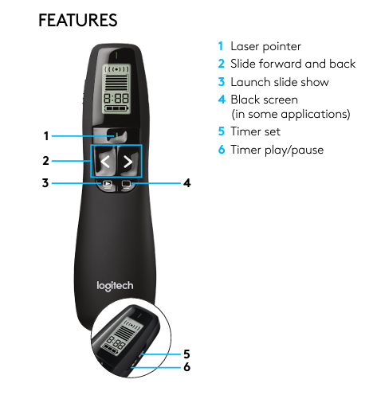
Presentation Room Example
Presenter Remote Control
YOU!
Podium Mic
Wide-screen Projection Display
Laptop
Presenter Remote
Podium

Slide 4
How long will you present during TECHCON?
You have a 20-minute time slot.
You should plan to speak for 15 minutes.
Five (5) minutes will be devoted to Q&A.
Prepare 1-2 questions to ask yourself in case the audience is quiet.
Your time will be strictly monitored.

Slide 5
What content should you present during TECHCON?
Your goal is to help the attendees understand your research and ideas.
Include your research motivation.
Include a slide that describes your technology transfer accomplishments.
Here is one way you might structure your presentation:
Introduction
Methodology
Results
Conclusion
Future Direction

Slide 6
Include Your Research Motivation
A slide should describe your research motivation.
Describe the problems addressed in your research.
Explain why this research is important to industry.
Remember that not everyone in the audience will be familiar with your research project.

Slide 7
Include Technology Transfer Accomplishments
A slide should describe your technology transfer accomplishments such as…
Industry Interactions
List any industry experts involved with your research.
Say a few words about your interactions with industry.
Internships (if appropriate)
Describe transfer/information exchange that happened during an internship at a member company.
Publications/presentations
Where is your work published?
Have you made a presentation to a member company?

Slide 8
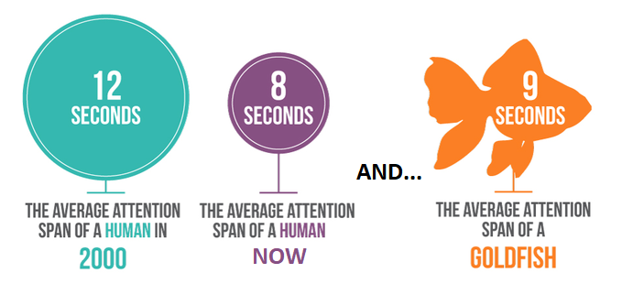
What presentation design skills are important?
Use clear illustrations. Ensure all lines, numbers, and captions are of sufficient thickness so that they are visible when projected.
Projectors are dimmer than computer screens so use high-contrast colors.
Limit the amount of information on each slide. Try to make sure that your message can be processed effectively within a few seconds.

Slide 9
What are some best practices for fonts?
Use 24-point font or larger. You will be presenting in a large room.
Limit your content to no more than 40 words per slide and not more than 8 lines per slide.
To avoid questions of PowerPoint compatibility and prevent nasty surprises, embed fonts. Learn more for Windows and for Macs.
Alternatively, convert fonts to vectors or use only universal fonts (e. g. Arial, Courier New, Lucida Sans, Times New Roman, Verdana).

Slide 10
Do not read your presentation. Address your audience directly to make a great impression!
Hi, I’m Christiana!

Slide 11
Mac Users—Special Notice
Please convert your file to PC format (or PDF) for presentation.
Be aware that Mac-to-PC PowerPoint conversions can lead to unexpected results, especially with fonts, certain formats of embedded graphics, and special characters.
Embed fonts to prevent nasty surprises. Learn more for Macs.
Alternatively, convert fonts to vectors or use only universal fonts (e. g. Arial, Courier New, Lucida Sans, Times New Roman, Verdana).

Slide 12
SRC Logo

