Slide 1
2026 Grubstake Application Webinar
July 15th, 2026

Slide 2
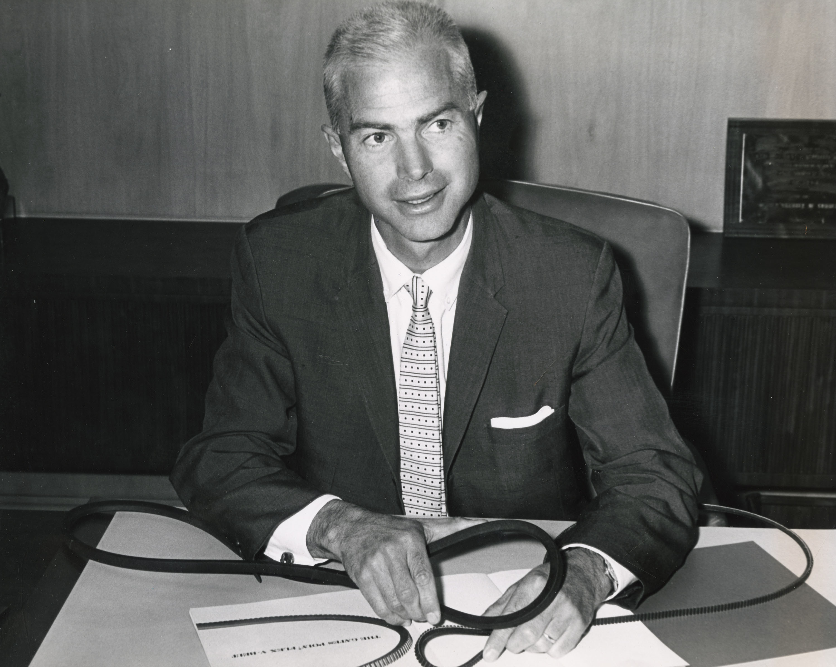
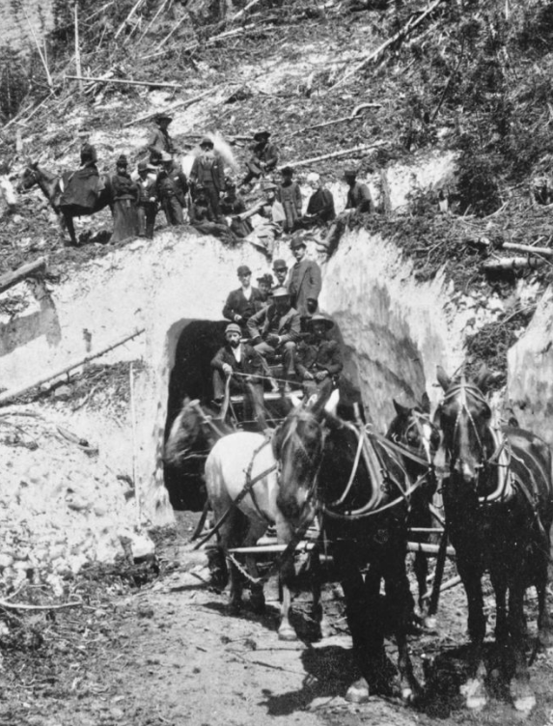
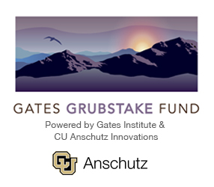


The History of Grubstake
Charles C. Gates (1921 – 2005) with V-belts made by his family's company in the early 1900's, which revolutionized power transmission
Grubstake: From grub (food) + stake (share). The term has origins in gold mining, where miners would get investors to fund their efforts in return for a cut of the profits. Earliest documented use: 1863.
Gates Grubstake Fund founded with a gift from former trustee Charles C. Gates in 1994

Slide 3
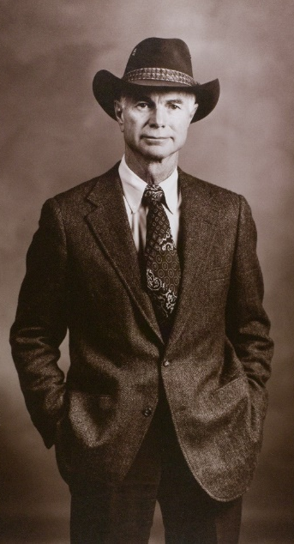
“Science and knowledge aren’t magic, they take hard work fueled by deep curiosity, intellectual honesty, tenacity in the face of adversity, and hope for a better world.”
“Set the bar high; clear it; and raise it further.”
“No one does their best work alone.”
-Charles C. Gates

Slide 4
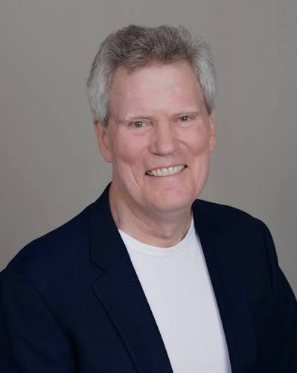
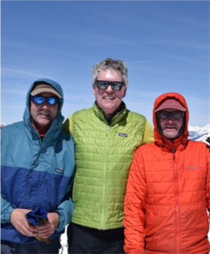
Mark Brunvand, MD – Physician-Scientist and Field Medical Director for CAR T-cell Therapy with expertise in immunology, stem cell transplantation, and cellular therapies for blood cancers.
Completed residency at the University of Colorado, gained a fellowship in Laboratory of Immunoregulation under Dr. A.S.Fauci, and the Fred Hutchinson Cancer Research Center before leading the development and expansion of Unrelated Donor stem cell transplant programs in Oregon and Colorado.​
Expanded Colorado's transplant program from fewer than 20 to more than 300 transplants annually, improving access to life-saving treatments and advancing innovative therapies that have enabled patients to recover and return to active, healthy lives.

Slide 5
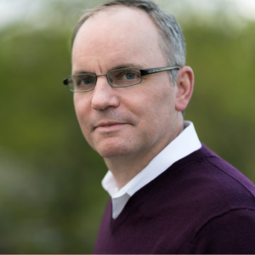
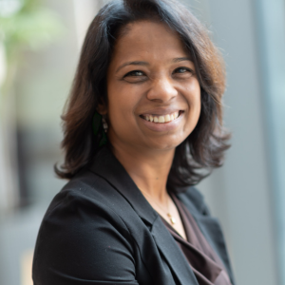
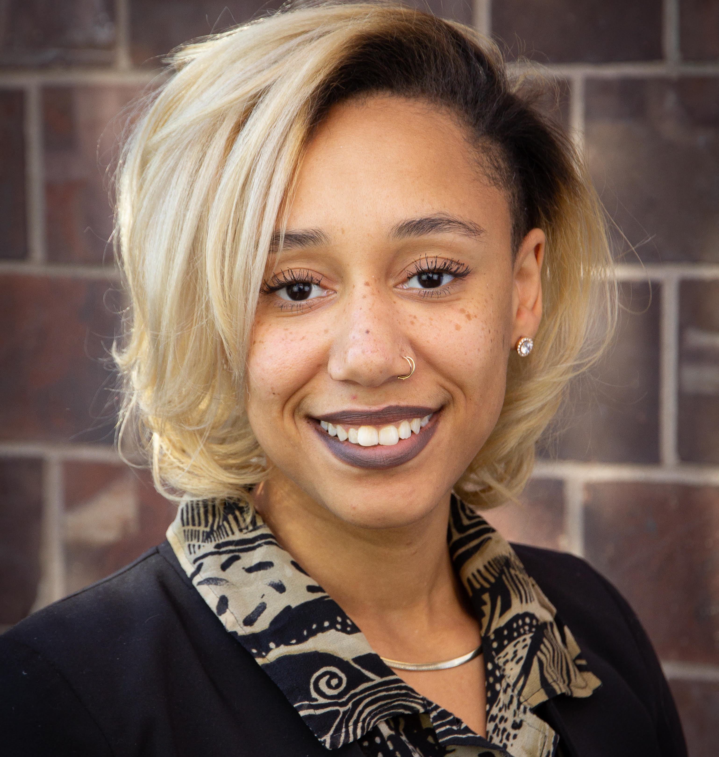
MEET THE TEAM
CHRIS GARBE
Technical Operations Director
VEENA Krishnamoorthy, PhD
Head of Preclinical Development
ASIA INGRAM, MS
CU Innovations Gates Fellow

Slide 6

2026 Grubstake Webinar Objectives
Familiarize applicants with the process and timeline
Clarify expectations for specific application sections
Explain the evaluation process and criteria
Describe awardee expectations and commitments
Describe additional resources available
Ultimately, the Grubstake Committee wants all applicants to feel appropriately informed and supported throughout the application process and post-award grant.

Slide 7
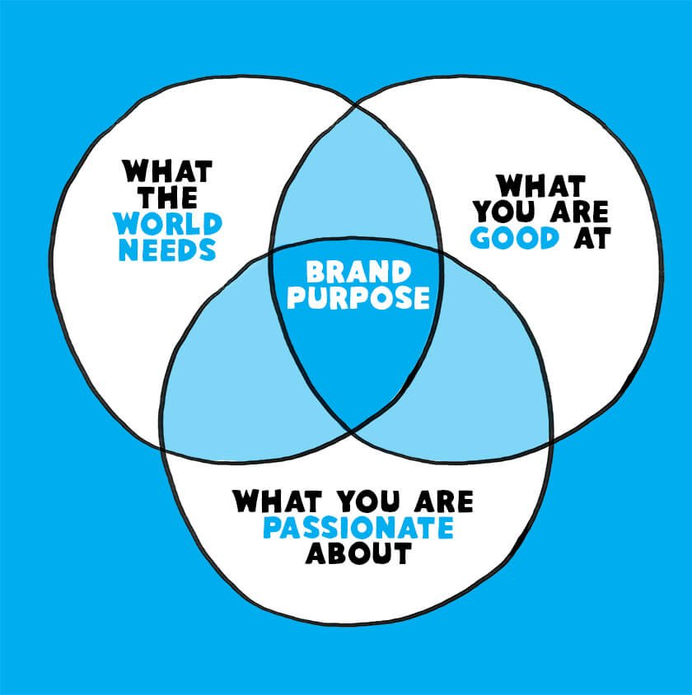
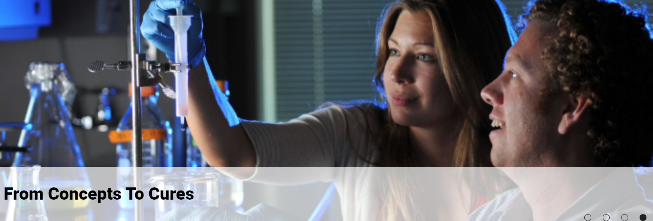
Grubstake Background and Purpose
Unmet Need:
  Many research projects experience funding challenges.
  Projects consistently run into ‘valleys of death’ throughout the product development lifecycle
Our Solution:
  Award supplemental funding to support high-impact, novel, early-stage (i.e., pre-clinical phase) projects
  The fund aims to support projects with a focus on eventual patient impact in indications with high unmet medical needs

Slide 8








Who Qualifies?
Academic researchers
Non-profits
Affiliation or direct collaboration with CU Anschutz (required)

Slide 9
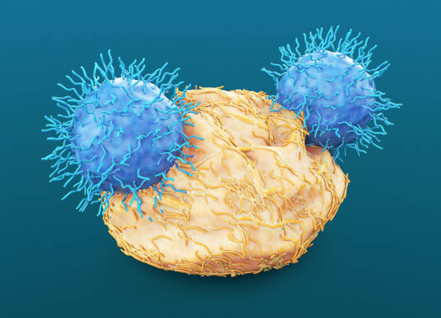
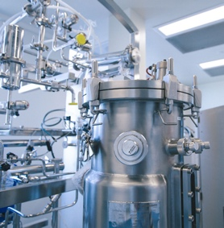

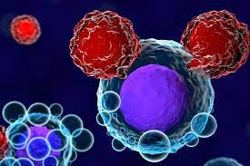
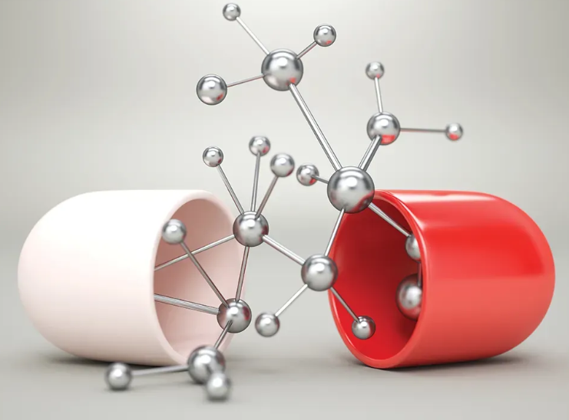
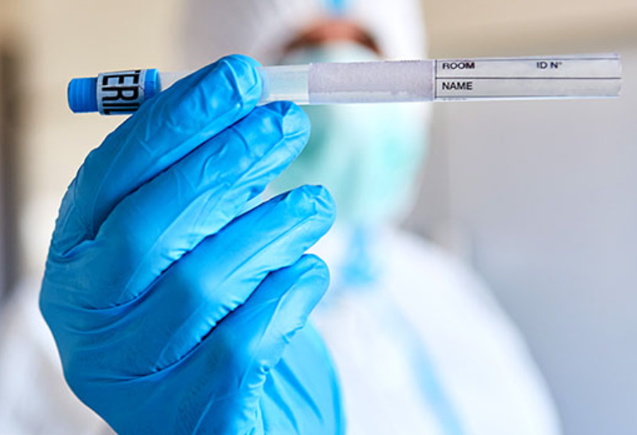
What Types of Projects Qualify?
Cell and gene therapies (e.g., CARs, TCRs, immune effector cells, gene editing technologies, etc.)
Biologics (e.g., recombinant proteins, RNAs, etc.)
Small molecules that can reprogram cells in situ
Stem-cell-based technologies
Devices that induce cell reprogramming or tissue regeneration
Companion diagnostics for any of the above products

Slide 10


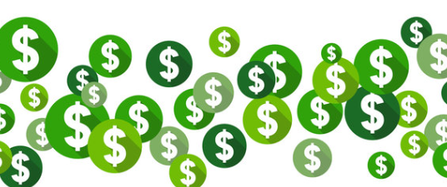
Funding and Funding Distribution
A TOTAL of $1.5MM is available to support multiple projects
Funding amount is commensurate with the product development stage and project objectives
Project can be funded across multiple years (2 years max)
Funding may be pulled for lack of progress and/or if it is not utilized entirely by the end of two years

Slide 11
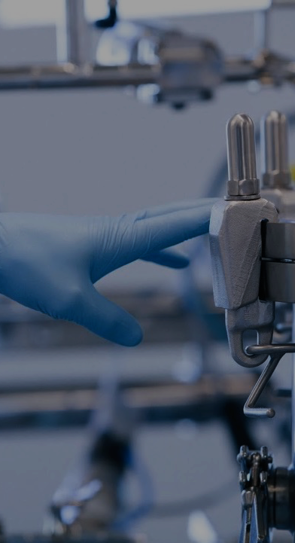
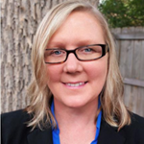
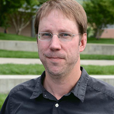
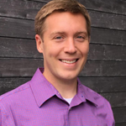
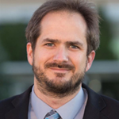
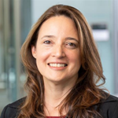
Previous Grubstake Award Winners
2025:
Christina Coughlan, PhD: "AD-Exo as a Plasmid-Based Diagnostic for Alzheimer’s Disease"
Jay Hesselberth, PhD: "Universal ASO Platform for Cryptic Exon Correction Across Genetic Diseases"
Wyatt Shields, PhD & Benjamin Bitler, PhD: "Macrophage Backpacks for Delivering Olaparib to High-Grade Serous Carcinomas"
Natalia Vergara, PhD: "Development of a Novel Therapy to Prevent Vision Loss in Age-Related Macular Degeneration"
2024:
Ram Nagaraj, PhD: "Gene Therapy for Diabetic Retinopathy"
Zhirui Wang, DVM, PhD: "CCR4 Immunotoxin for Breast Cancer Immunotherapy via Treg Depletion"
Michael Verneris, MD and Traci Lyons, PhD: "Sema7a Targeted CAR T-cells for Women's Cancer"
Christian Young, PhD: "First-in-class topical biologic to treat atopic dermatitis”
Yuwen Zhu, PhD: "Developing a humanized GPR182 blocking mAb for immunotherapy”

Slide 12


Evaluation Committee
The evaluation panel consists of:
  Approx. 8-10 core, voting members
  Gates Institute, CU Innovations, external members
  Expertise in start-ups, intellectual property, venture capital, financing, product development
  The committee may enlist ad hoc members with subject matter expertise as needed
  All members are either University-affiliated or under CDA

Slide 13


Evaluation Rubric
The Evaluation Committee uses an evaluation rubric to score projects:
  Designed to follow the general categories of the application
    Mission Alignment
    Scientific Merit / Intellectual Property
    Patient Impact / Clinical Feasibility
    Manufacturing and Regulatory Feasibility
    Budget and Competitive Landscape
  Uses weighted scoring (i.e., each scoring parameter carries a specific weight) in line with the application weighting

Slide 14



2026 Grubstake Application Important Dates
SEPTEMBER 14 – APPLICATIONS DUE through the portal
Mid-End October 2026 – Finalists for pitch night selected
Early-Mid November 2026 – Pitch Night practice sessions
Mid-End November 2026 – Finalist Pitch Night
Mid-December 2026 – Awards Announcement

Slide 15

Important Application Notes
Specific Application Sections have weighted values:
  Scientific Merit (25%)
  Mission Alignment (20%)
  Patient Impact / Clinical Feasibility (25%)
  Manufacturing and Regulatory Feasibility (15%)
  Budget and Competitive Landscape (15%)

Slide 16

Important Application Notes
The application must be submitted through the online portal
  For those who want to work on the application offline, a word document is provided. Complete each section and cut/paste into the online application. We advise all applicants to work offline first.
There are word limits for certain sections (varies by section)
Each section holds a scoring weight and is evaluated accordingly
Additional sections are provided for attachment of data, tables, figures, etc.
  Supports multiple file types (png, jpg, tiff, ppt, doc, pdf, xml, xlsx)
  Video can be used by embedding into a ppt and uploading to the portal
  Number of attachments and file size limitations are provided (e.g., 1 figure, 25MB max per file, etc.)
  Take advantage of attachments to provide supportive and supplemental information

Slide 17



Grubstake Application
Part 1: Product Introduction
  High-level project background, product category, investigators involved, funding request, etc.
Part 2: Project Information
  Introduction
  Product / Scientific Merit
  Intellectual Property
  Mission Alignment
  Patient Impact
  Manufacturing and Regulatory Feasibility
  Budget and Competitive Landscape

Slide 18
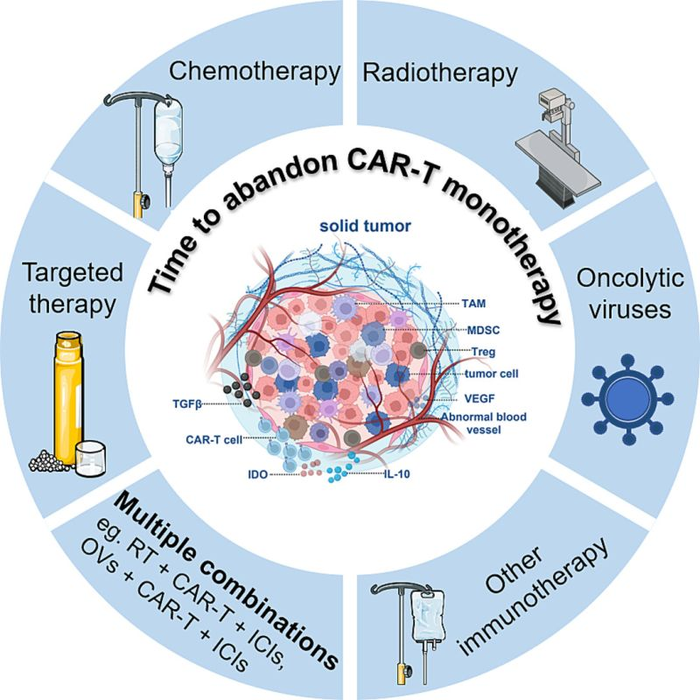
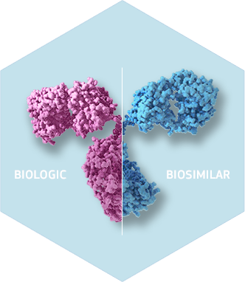
Part 1: Introduction
General project overview and information including:
Section is self-explanatory
  Principal Investigators
  Overview of Project and Current Status
  Funding Request and Budget Summary
    How much is the request?
    For how long? Reminder: maximum duration of 2-years
    For what activities to advance the project?
    To get to what proof of concept or value-add inflection point(s)?

Slide 19


Part 2: Project Information
Introduction:
  600 word maximum
  Be clear, concise, and compelling!!
  There is specific information required in this section
    Summary of the technology, work conducted to date, and what still needs to be accomplished to demonstrate proof-of-concept
    What is its purpose?
    What unmet medical need is being addressed?
    How does this technology either supplement, enhance, or replace the current standard of care?
  Balance the information between a high-level summary and sufficient details to convince a reasonably versed reviewer of the product differentiation.
Get the reader excited and wanting to know more!!

Slide 20

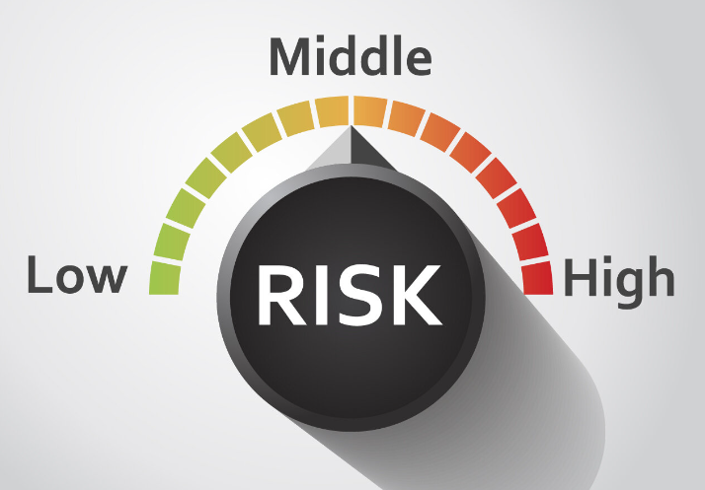
Part 2: Project Information
Product / Scientific Merit (25%):
  1000 word maximum
  Be clear, concise and compelling!!
  Specific requirements for this section include:
    Product description
    Development history
    Future steps and milestones
      These encompass near (1-2 year) and longer-term milestones
      Include what development inflection points the Grubstake award will help accomplish
    Risks
      Include not only challenges this project faces, but also potential mitigation approaches
      Challenges may include competing technologies, shifting patient standard of care practices, regulatory landscape, intellectual property, etc.
  Applicants are strongly encouraged to include graphs, figures and tables that support your scientific claims

Slide 21



Part 2: Project Information
Intellectual Property:
Indicate if CU Innovations applied for intellectual property protection covering this technology and provide reference numbers
If there is no related patent, provide information on the intellectual property strategy
Minor change in few questions from last year:
  Asking applicants to indicate if their product and/or process is optioned or licensed and if so to whom?
It is required that all applicants submit an invention disclosure to CU Innovations prior to receiving Gates Grubstake funding
Please contact CU Innovations for further assistance or guidance with Intellectual Property

Slide 22
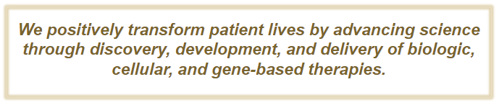


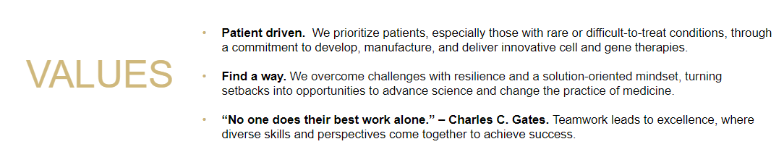
Part 2: Project Information
Mission Alignment: (20%)
  100-150 word maximum per subsection
  Specific requirements for this section include:
    Provide rationale and justification that your innovation aligns with and contributes to the Gates Institute Mission and Values
    Include if and how your project aligns with the Gates Biomanufacturing Facility capabilities, wherever possible
    Provide any campus, academic or industry collaborations and how each impacts your project

Slide 23



Part 2: Project Information
Patient Impact / Clinical Feasibility (25%):
  500 word maximum
  Specific requirements for this section include:
    Potential patient impact; How will this technology benefit individual patients?
    Target patient population and high-level clinical trial design
      Include a rough clinical synopsis for your product, if available.
    Projected time to first-in-human clinical trial initiation
    Is there a potential for this technology to treat rare diseases?

Slide 24
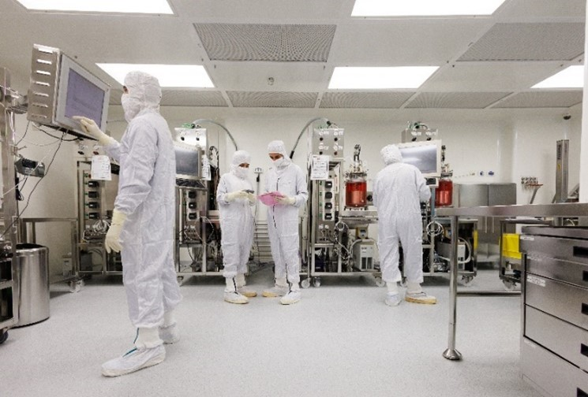

Part 2: Project Information
Manufacturing and Regulatory Feasibility: (15%)
  500 word maximum total for both sections
  Specific requirements for this section include:
    Details on Manufacturing Feasibility
    Details on Regulatory Feasibility

Slide 25

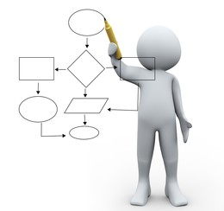
Part 2: Project Information
Manufacturing Feasibility consists of the following :
  What does the proposed manufacturing process look like? (i.e., unit operations, process flow diagrams, controlled condition requirements, duration, etc.)
  Current scale and proposed scale needed at clinical trial initiation
  Where you propose to develop, scale-up and manufacture your product to support first in human clinical trials
  Identify any critical starting or raw materials (e.g., patient tissue, iPSCs, animal derived materials, containing unique properties, etc.)
Outline potential manufacturing issues
  Unique or complex process/purification schemes or those that may require automation
  Custom materials needs (e.g., 3D printing, custom synthesis, etc.)
  Development of unique, complex, or non-existent analytical methodologies
Include potential mitigation strategies for each perceived hurdle
Gates Biomanufacturing Facility management can provide further assistance and guidance, as needed

Slide 26


Part 2: Project Information
Regulatory Feasibility consists of the following:
Describe your proposed regulatory strategy to first in human trials
  What is the proposed regulatory pathway (i.e., CBER, CDER, CDRH; stand-alone product, combination product, diagnostic)? Seeking orphan drug designation? Phase 1 straight to pivotal?
  Are their any current products/technologies that could be used as a guide?
  Who do you intend to ‘Sponsor’ the investigational trials? Academic vs. Industry
Milestones and estimated timeline to reach IND submission
  Provide a high-level timeline to reach milestones (INTERACT, pre-IND, IND)
Any potential regulatory issues/hurdles
  Does your product or technology face any unique regulatory hurdles?
  Is it first-in-class? New modality? Unique application? Gene-modified?
  Provide proposals to mitigate any identified challenges
Gates Institute Regulatory can provide further assistance and guidance, as needed

Slide 27




Part 2: Project Information
Budget and Competitive Landscape Plan: (15%)
Consists of six (6) subsections:
    Budget
    Additional Support Required (200 word maximum)
    Market Analysis (250 word maximum)
    Competitive Landscape (250 word maximum)
    Engagement (150 word maximum)
    Bench to Bedside Experience (150 word maximum)
A PRELIMINARY BUDGET IS REQUIRED TO BE SUBMITTED WITH EACH APPLICATION
A TEMPLATE IS PROVIDED FOR BUDGET. PLEASE USE THE TEMPLATE TO COMPLETE YOUR MONETARY REQUEST.
Please reach out to Gates Institute Finance or CU Innovations for further assistance or guidance with Budget or Competitive Landscape, respectively

Slide 28
Part 2: Project Information
A TEMPLATE IS PROVIDED FOR BUDGET. PLEASE USE THE TEMPLATE TO COMPLETE YOUR MONETARY REQUEST.
Budget Example
Gates Grubstake 2026 Budget Breakdown
Year 1 accommodate | Year 1 Funding Total: $000000000 | Milestone | Funding Breakdown | Funding Breakdown
 |  | Milestone 1: Projected Date 00/00/0000
 |  | Details: | Equipment
 |  |  | Luminex Machine | $5,000.00
 |  |  | Personnel (%effort)
 |  |  | Personnel 1 %10 effort | $65,000.00
 |  |  | Personnel 2 %30 effort | $45,000.00
 |  |  | Fringe (as a percentage of personnel costs)
 |  |  | Animal Costs
 |  |  | Supplies (Consumables, Core Costs…etc)
 |  |  | FDA IND Filing Fees
 |  |  | Publication
 |  |  | example… Nature Publication Revisions | $1,500.00
 |  | Milestone 2: Projected Date 00/00/0000
 |  | Details: | Equipment
 |  |  | Personnel (%effort)
 |  |  | Animal Costs
 |  |  | Supplies (Consumables, Core Costs…etc)
 |  |  | FDA IND Filing Fees
 |  |  | Publication
 |  |  | Fringe

Slide 29
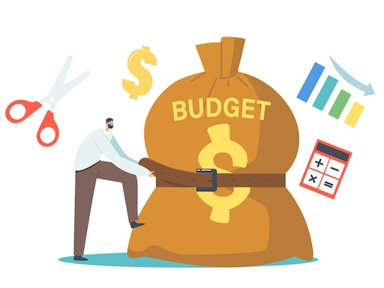

Part 2: Project Information
Budget and Competitive Landscape Plan: (15%)
Budget
  Simple budget template is provided in the application
  Initial high-level budget should include major expected expenditures with approximate timing (e.g., equipment and material purchases, etc.)
  Amortize consistent, routine expenditures over the entire project duration
  Tie expense to a specific project aim or goal (e.g., to conduct animal model studies)
  If a multi-year project, provide a yearly budget (expenses in Year 1 vs. Year 2)
  Budgets will be reviewed and vetted as part of the evaluation process
Additional Support Required
  Provide an estimated overall resource need (time, money, people) to advance your project beyond the Grubstake award goals into first in human clinical trials
Please reach out to Gates Institute Finance team for further assistance or guidance with Budget

Slide 30

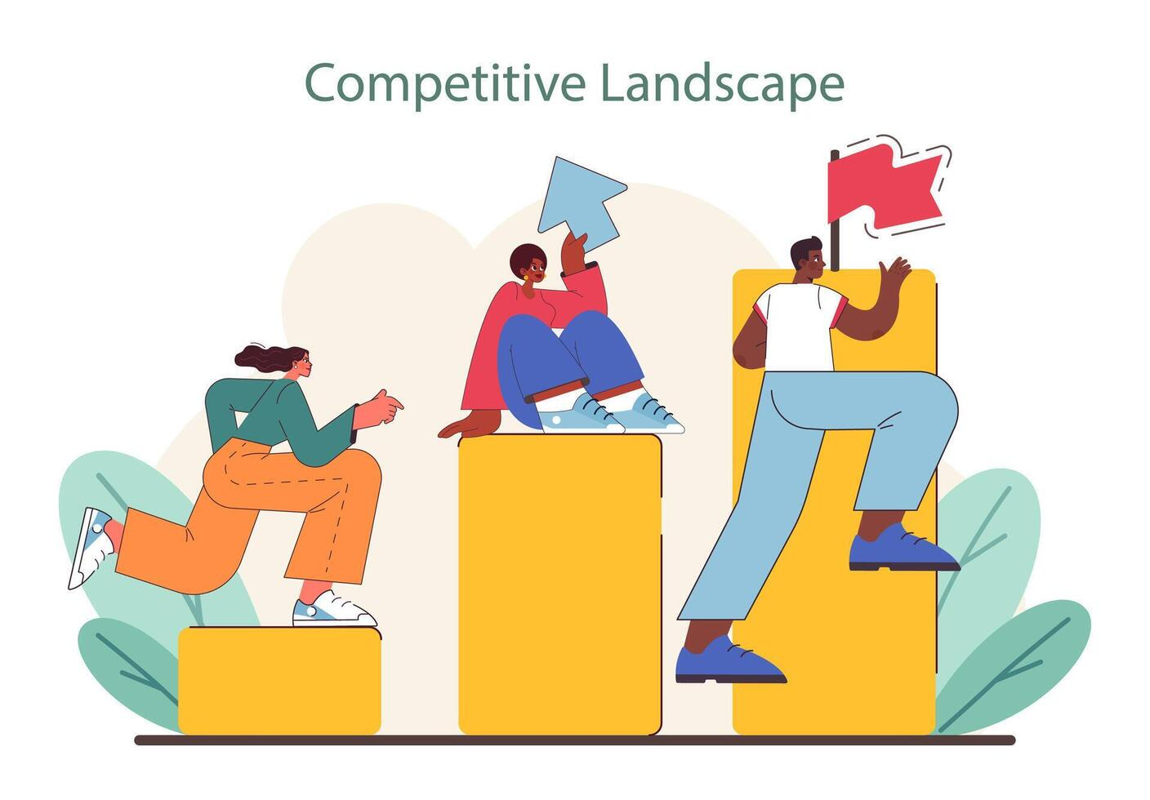
Part 2: Project Information
Budget and Competitive Landscape Plan: (15%)
Market Analysis
  We expect applicants to understand their target market, conduct market analysis research, and provide a summary of findings
  What is your target market? (e.g., patient population, indication, market value, etc.)
  What is the existing standard of care?
  What opportunities exist for growth or expansion into secondary/future markets?
  What are your assumptions regarding the future of the target market? (e.g., we expect the market to grow X%, CAGR, etc.)
Competitive Advantage
  What competitors are there, and advantages does your product, technology, approach provide over similar products or the current standard of care or those in clinical trials?
  How will your product or technology continue to distinguish or differentiate itself?
Please reach out to CU Innovations for further assistance or guidance on Market Analysis or Competitive Advantage analyses

Slide 31


Part 2: Project Information
Budget and Competitive Landscape Plan: (15%)
“No one does their best work alone.” – Charles C. Gates
Engagement
  Indicate how you, your team, and your project are connected to the greater Anschutz and/or Colorado community
  Explain the diversity and combination of expertise and experience your team brings with the proposed project
  How will the individual expertise/experience be leveraged to succeed?
Bench to Bedside Experience
  Emphasize any prior experience with product/technology development from research to clinical trial, and how those experiences will translate to the current project

Slide 32


Follow-on Requirements/Requests
If you are a Grubstake Awardee, you are expected to…
Provide regular scientific updates, a minimum of every six (6) months, to Gates Institute and CU Innovations
  Publications or abstracts on campus or at scientific meetings
Outcomes of using the Grubstake award
  Publications, patent applications, etc.
  Follow on funding, licensing opportunities
Project progress or ‘off-shoots’
  New indications, new technologies
  Next generation products
  Discontinuations
Recommend follow-on participation with Grubstake

Slide 33


Application Resources
We encourage applicants to engage with the following groups if there are any questions during the application process:
  General application: Gates Grubstake Planning Committee
    Grubstake.award@olucdenver.onmicrosoft.com
  Intellectual Property and Competitive Landscape: CU Innovations
    Doreen Molk for Intellectual Property: DOREEN.MOLK@CUANSCHUTZ.EDU
    Lili Uchida for Competitive landscape: LILI.UCHIDA@CUANSCHUTZ.EDU
    Budget:
    Joleen Bohnen: JOLEEN.BOHNEN@CUANSCHUTZ.EDU
  Manufacturing: Gates Biomanufacturing Facility
    Joleen Bohnen: JOLEEN.BOHNEN@CUANSCHUTZ.EDU
    Chris Garbe: CHRISTOPHER.GARBE@CUANSCHUTZ.EDU
  Regulatory and Non-Clinical Questions: Gates Institute Regulatory group
    Cheri Adams: CHERI.ADAMS@CUANSCHUTZ.EDU
    Veena Krishnamoorthy : VEENA.KRISHNAMOORTHY@CUANSCHUTZ.EDU

Slide 34

Open Q+A Session

Slide 35

Q: Can for-profit, start-up organizations apply?
Answer: Yes. start-ups and for-profits may apply for Grubstake funding IF the organization is affiliated with CU Anschutz. The award will go to the CU Anschutz investigator, NOT the industry entity.
Q: Is my technology aligned with Grubstake/Gates Institute if it cannot be manufactured by GBF?
Answer: Yes. While it is preferred that your product or technology align with and could be manufactured using GBF, we acknowledge that there are limitations and may not always be the case. While this is preferred and considered during the evaluation process, it is not an absolute requirement or deal-breaker.

Slide 36
Q: Can I apply multiple times for a Grubstake Award?
Answer: Yes. A Principal Investigator may submit multiple applications for different projects within the same year or across multiple years. Our recommendation is to submit one (1) focused application within a Grubstake award cycle.
We also encourage those with projects that were not awarded in a previous year to re-submit a new application and include supplemental development information. The Grubstake Committee is willing to discuss what elements of a previous application may have had room for improvement.
Finally, we have eliminated the Second Tranche funding mechanism. If you wish to apply for additional funding to a prior Grubstake funded project, you must submit a new application for evaluation and consideration.

Slide 37
Q: Is a funding match needed?
Q: How far should the budget timeline extend?
Answer: The budget provided within the application should be reflective of the major activities and milestones that you intend to have funded using the Grubstake award over the entire award period.
Keep in mind there is also an ‘Additional Support’ section under ‘Budget and Competitive Landscape’ for projected funding needs beyond the Grubstake award.
Answer: No. The Grubstake award is intended to be a stand-alone funding mechanism for novel, groundbreaking, early-stage research projects. There is no requirement for an award match.

Slide 38
Q: If selected, who will be the audience at Pitch Night?
Q: How many applicants move on to Pitch Night?
Answer: It depends on the quality of the proposed projects and scoring competitiveness. Typically, we try to limit Pitch Night to 5-6 invited Finalist projects, of which the Evaluation Committee will then decide on which projects are selected for funding.
Answer: Pitch Night is currently scheduled to occur in November of 2026. The audience will consist of Evaluation Committee members. In addition, ad hoc subject matter experts and representatives from CU Innovations and Gates Institute may be in attendance and participate as non-voting members.

Slide 39
Q: How many projects are selected for funding awards?
Answer: It depends on the quality of the proposed projects and the requested funding amounts. Due to the variability now allowed in requested funding amounts, Gates Grubstake intends to fund multiple projects up to an aggregate amount of $1.5MM.
Historically, when funding under the fixed amount model, Grubstake awarded 3-4 projects per year.

Slide 40
Q: How will Grubstake funds be distributed?
Answer: Gates Institute Finance will generate and issue a speedtype for each awardee. Funds will be distributed in tranches and in alignment with your vetted and agreed upon budget and milestone timeline. Therefore, it is important to be a clear as possible with your proposed budget within the application. We strongly encourage applicants to reach out to Gates Institute Finance with any additional questions.
Q: Are there any spending restrictions for Grubstake funds?
Answer: Yes. Please consult with Gates Institute Finance for additional information.

